Slide 1
Kaiqi’s G20 Analysis
DATS 6401 - Individual Project
Presented By
Kaiqi Yu

Slide 2



Catalog
HomePage
GDP
Education
Healthcare
Military
Others
z

Slide 3
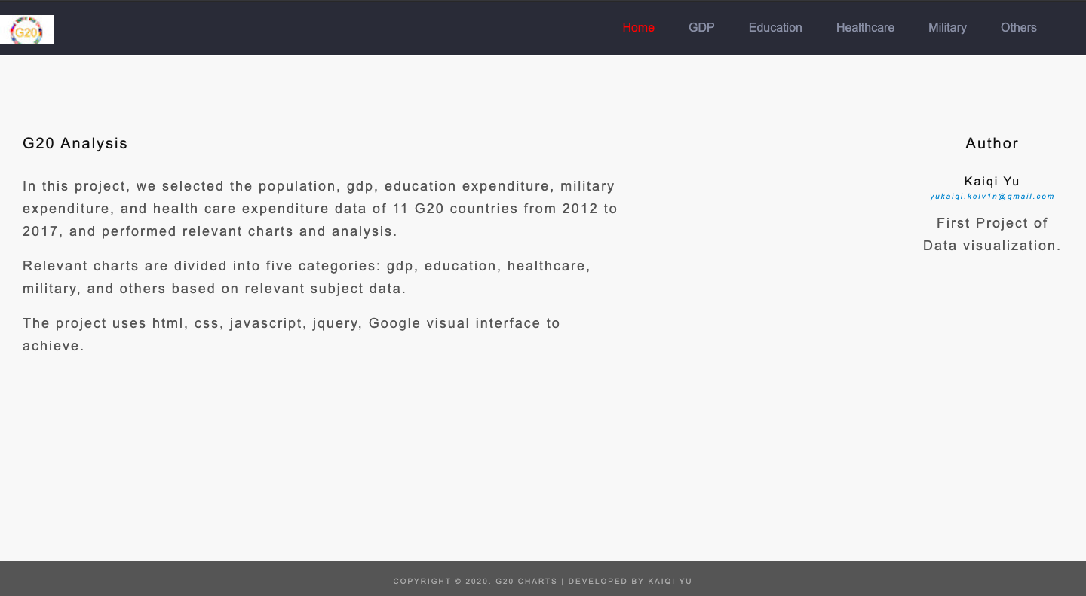
HomePage

Slide 4
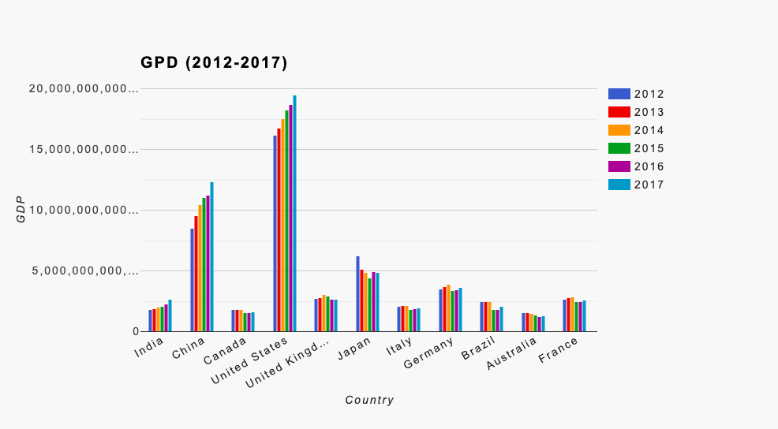
GDP

Slide 5
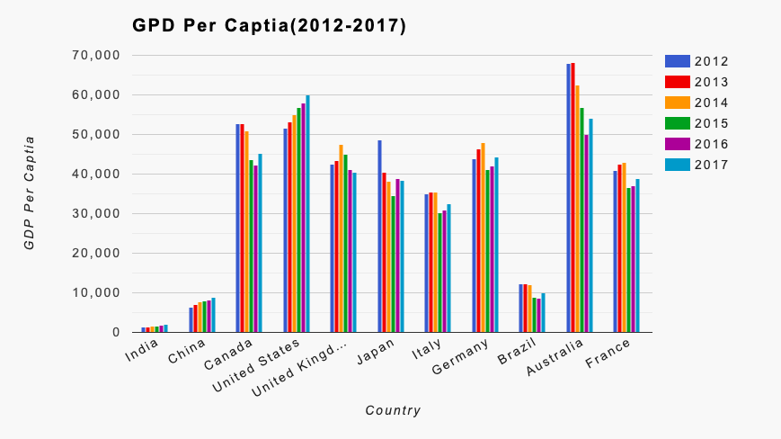
GDP Per Captia

Slide 6
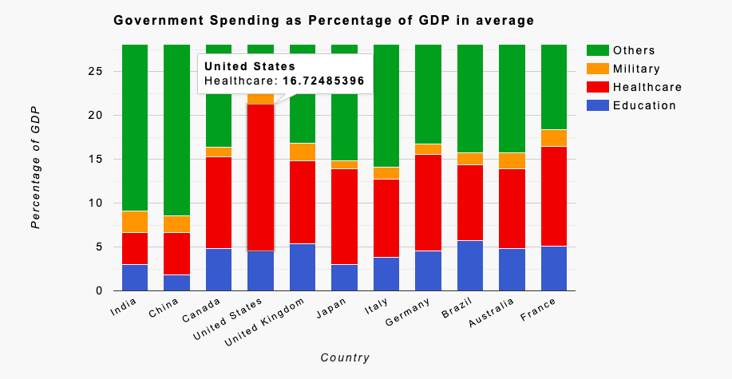
Government Spending as Percentage of GDP in average

Slide 7
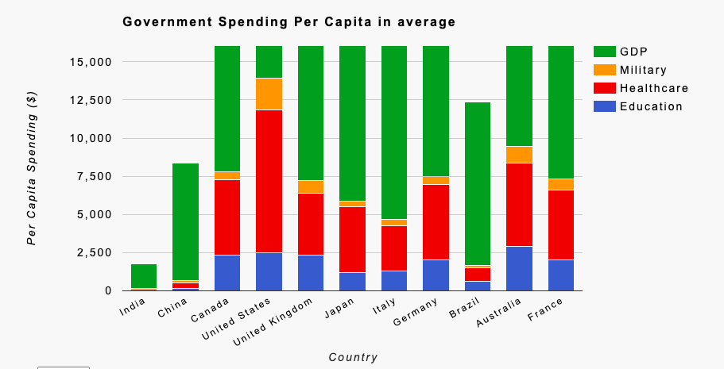
Government Spending Per Capita in average

Slide 8
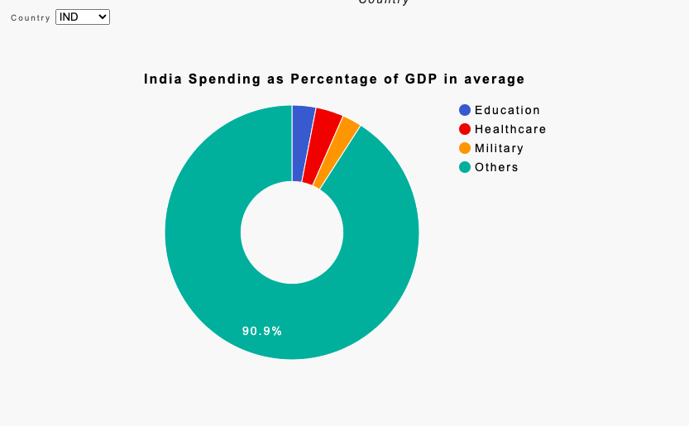
Country Spending as Percentage of GDP in average

Slide 9
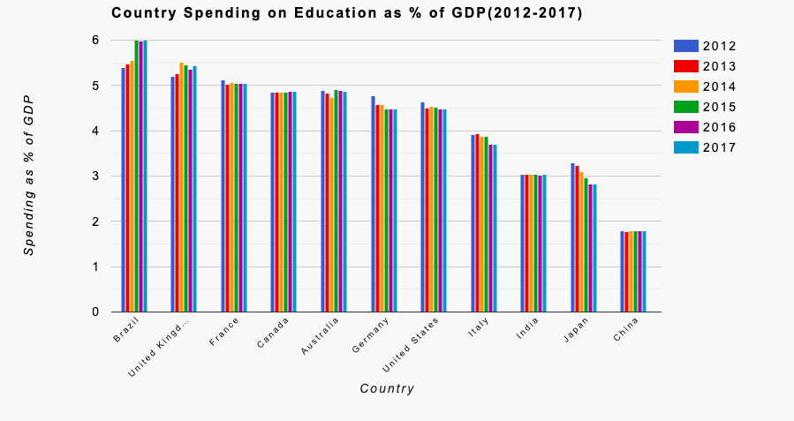
Education

Slide 10
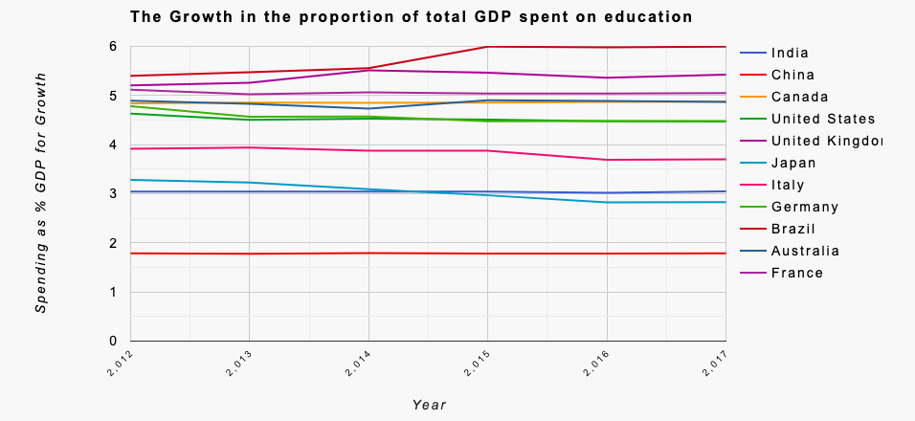
The Growth in the proportion of total GDP spent on education

Slide 11
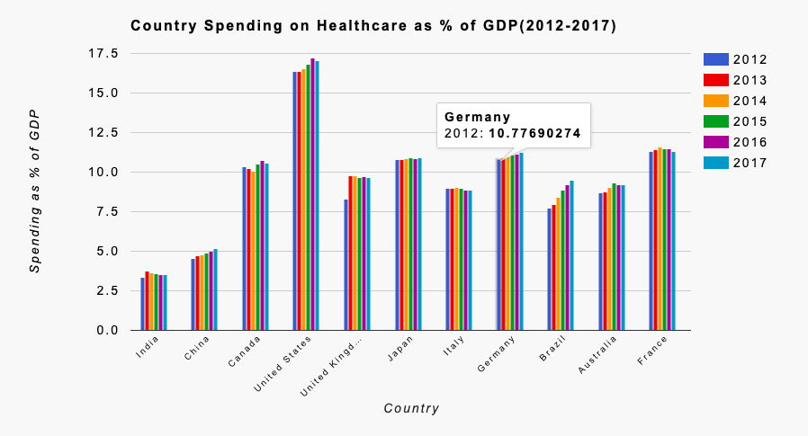
Healthcare

Slide 12
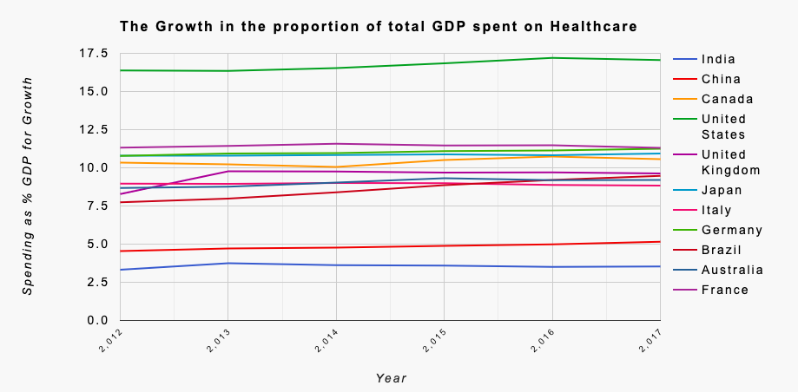
The Growth in the proportion of total GDP spent on healthcare

Slide 13
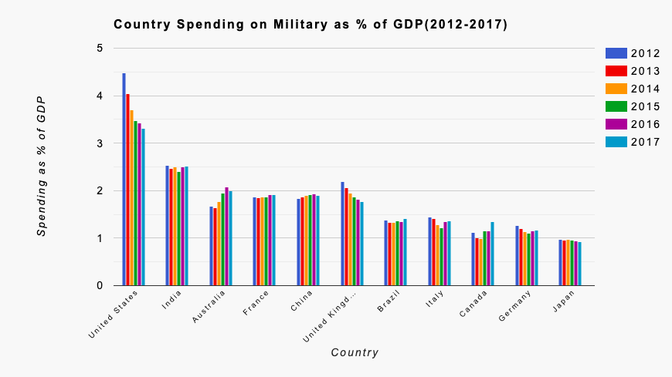
Military

Slide 14
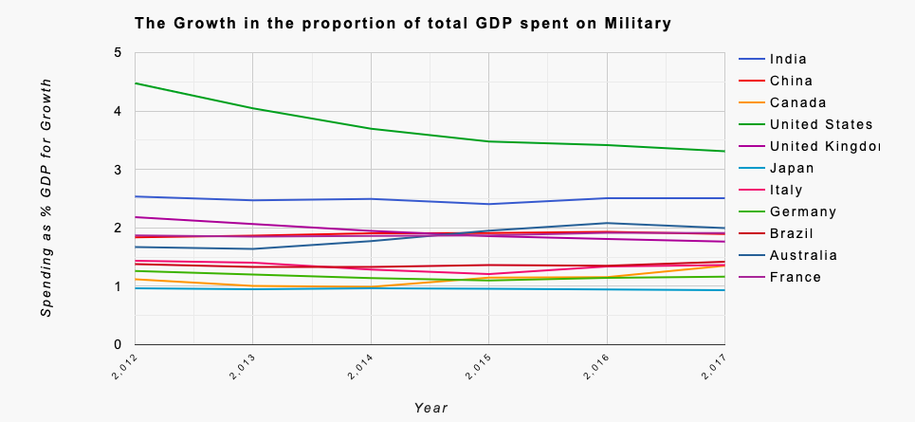
The Growth in the proportion of total GDP spent on military

Slide 15
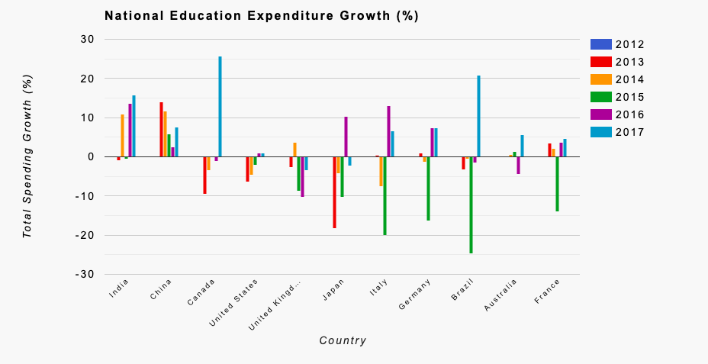
Others

Slide 16
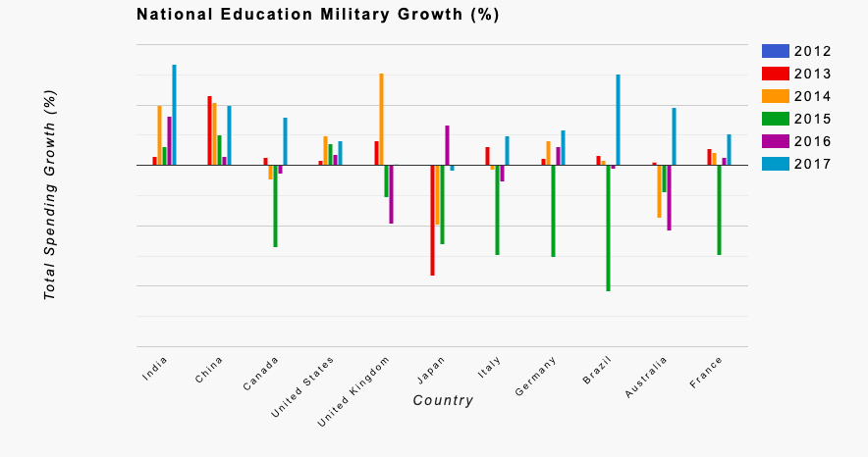
Others

Slide 17
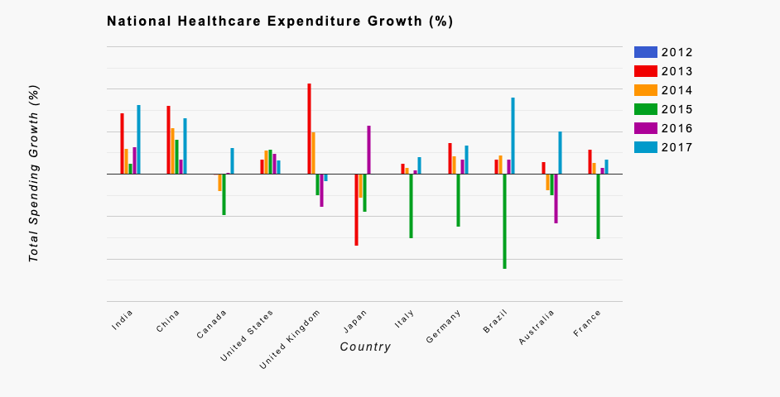
Others

Slide 18
Thank you
z

